Slide 1
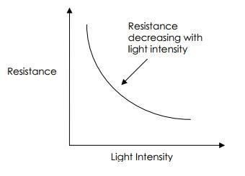
ABSTRACT WIFI CONTROLLED AUTOMATIC CURTAIN CONTROLLER
INTRODUCTION:
We control the movement of curtains in our home by the variation of light intensity present outside the room. The LDR is connected to Nodemcu, to which we write code to control the dc motor. Here to control the dc motor we interface Nodemcu and motor with motor driver(L298N)
We give a power supply of 12 v, in which 3.3 v is used to power Nodemcu and the remaining goes to motor driver in which there is a voltage regulator that limits voltage such that output current is sufficient to drive the DC motor
COMPONENTS AND SPECS:
Resistor 10k ohm - 1 No.
LDR - 1 No.
Nodemcu(ESP8266) - 1 No.
DC motor driver(L298N) - 1 No.
High torque dc motor(5 V) - 1 No.
DC Battery(12 v) - 1 No.
Arduino IDE software
Connecting wires(Jumpers)

Slide 2
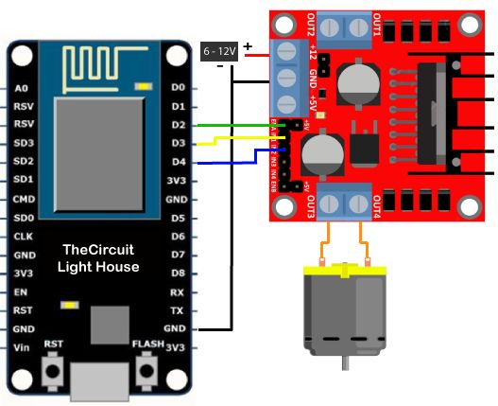
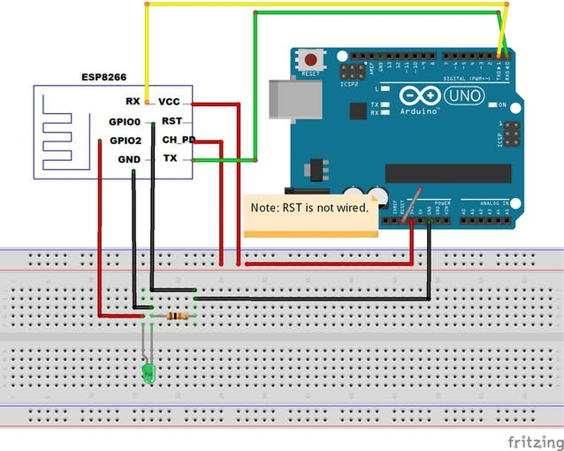
In general, when some lumens of light falls on LDR the resistance across LDR terminals vary from 5k ohm(in daylight) to 20M ohm(in dark).now, as we connect it to Nodemcu, which in turn is connected to computer.it changes all analog values to digital domain and outputs the values ranging from 0 to 1024
CONNECTIONS:
ROLL NUMBERS:
1602-17-735-078(KAUSHIK-CODING)
1602-17-735-080(MANASA-PRACTICAL IMPLEMENTATION)
1602-17-735-092(RAVI-DESIGN OF INTERFACING BETWEEN VARIOUS COMPONENTS)
1602-17-735-118(YASHITA-CODING)

